Slide 1
Products
Agriguarb
Biojeb
Poshan
Sticker
Agrizyme
Agrolive
Agrinol
Chelazin(chelated Zinc)
Agricin
Agroliv(potato Special)
Agroliv(Cole crop Special)
Agroliv(Tea Special)
Poshan(Tea Special)
Agrizyme(Tea Special)

Slide 2
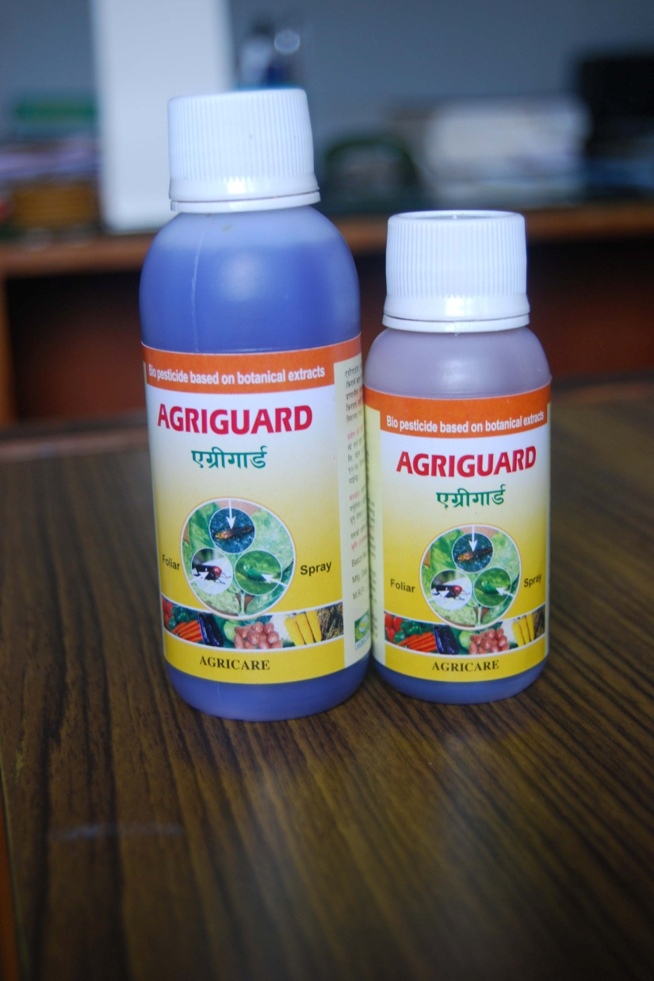
Agriguard
AGRIGUARD is a systemic botanical insecticide prepared from alkaloids derived from selected herbs .All the alkaloids are physiologically
active and effectively control infestations of pests like sucking and chewing pests ,caterpillar , thrips , aphids and jassids.
AGRIGUARD attacks the central nervous system of the insects and increases excitability , reduces eating activity, disturbing entire physiological coordination results death of insects. CROP: Paddy & other cereal crops, oil seeds, vegetables, Pulses, Flower, Fruits and tea
Mode of application: 2ml per Lit. water is recommended
CAUTION: Use the solution immediate after preparation. Do not store it for longer time. After spraying, wash hands and contaminated parts of the body and sprayer as well. Keep away
from children and pets. Keep away from direct sun light.
Presentation: 50 ml, 100 ml. 250 ml, 500 ml.
FOR AGRICULTURAL USE ONLY

Slide 3
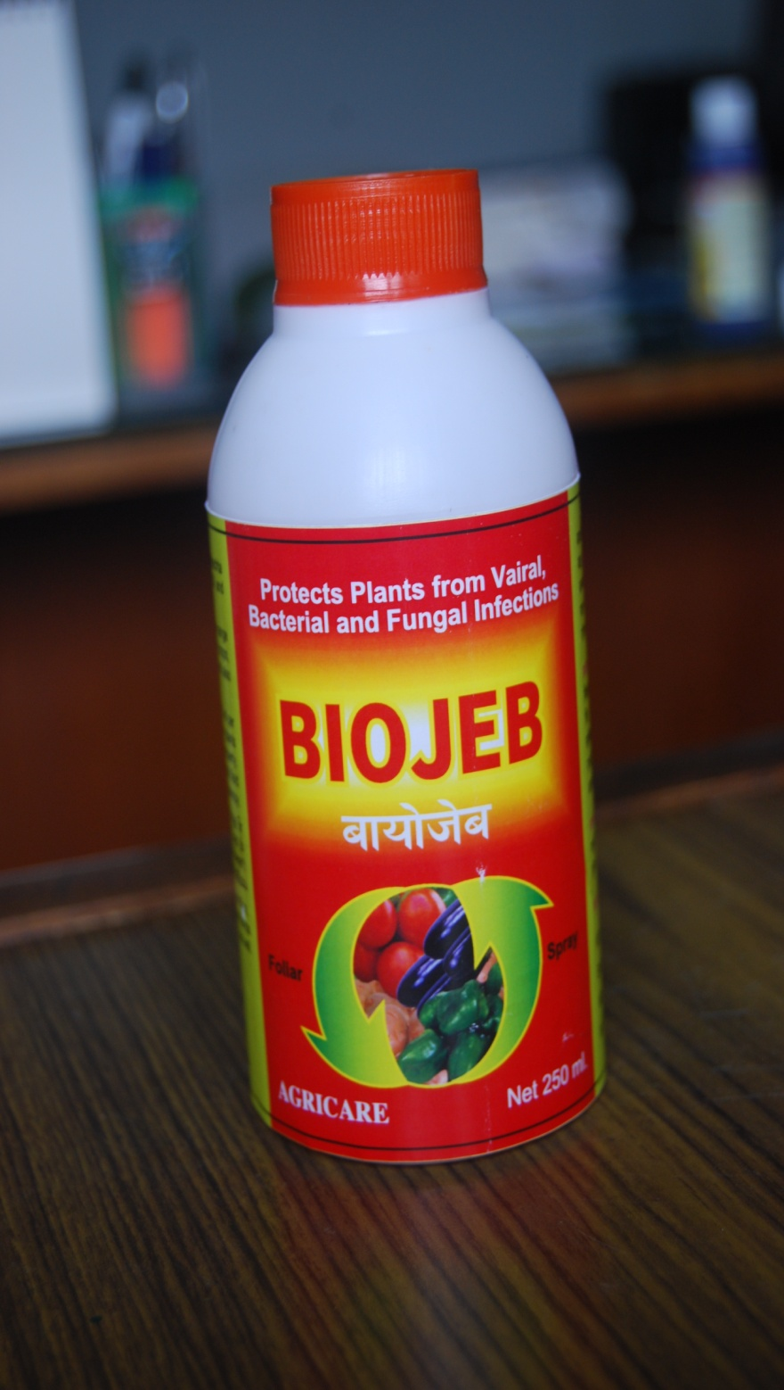
Biojeb
BIOJEB ( BOTANICAL FUNGICIDE )
Biojeb is a botanical based fungicide. It contains a complex of physiologically active alkaloids isolated from selective Himalayan herbs .Biojeb can control effectively leaf blight, wilt, rots ,powdery mildew etc. It can be applied on the crops like Paddy, Soybean ,Tea, Potato, Onion, Garlic, Brinjal , Chilli, Tomato ,Fruits like Mango ,Grapes, Oil seeds and on the flower plants specially on Rose.
Composition:
Complex of Alkaloid 8.0%
Surface active agents 24.0%
Plant protein Hydrolyser 18%
Other 50.0%
Total : 100.0%
Mode of application: 1-2 ml per Lit. of water is recommended. On heavy fungal infestations, the dose may be increased. Biojeb can be used with other chemical pesticide or fungicide .Biojeb is non phototoxic and non toxic to human ,birds ,earth worms or animals. It does not leave any residual effect on leafs after application .
FOR AGRICULTURAL USE ONLY

Slide 4
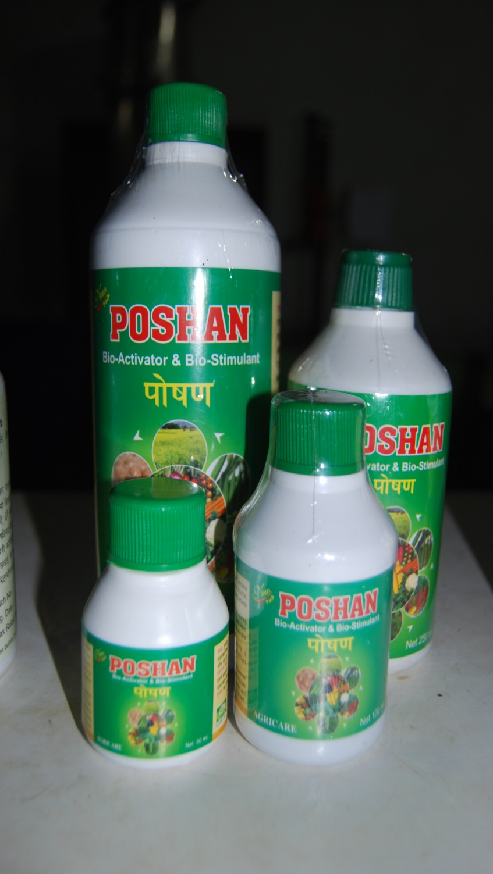
Poshan
POSHAN is a natural Bioactivetor & biostimulant, contains hydrolysed protein derived from organic source, aminoacids, auxin precursor, cytokinines, sea-weed extracts and essential trace elements.
POSHAN is a foliar spray ,catalyzes growth during vegetable to reproductive stages and accelerates higher utilisation of nutrients in available form results higher yield of quality crops
Application: 1 ml Poshan to be mixed with 1 lit. of water ,thus 300 lit. solution can be prepared and sprayed over 1 acre of standing crops.
Caution: Do not mix Poshan with other pesticides or fungicides for better result. Use the solution immediate after preparation. After spraying, wash hands and contaminated parts of the body and sprayers as well.

Slide 5
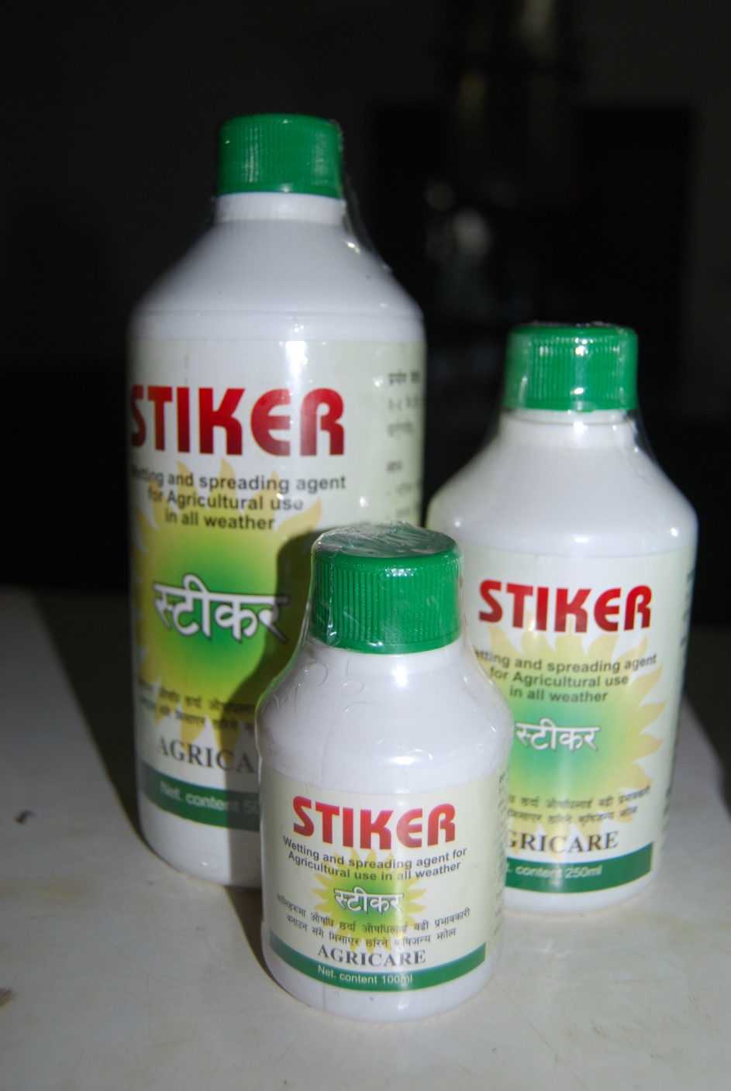
Sticker
Composition:
Stiker is a blend of surface –active agent and co-adjuvant with detergent .
Benefits:
Stiker helps to accelerate spreading on leaf surface
Improves wetting and spreading quality of spray solution.
Enhances the duration of product efficacy.
Stiker is a unique carrier to make available more chemical inside the leaf tissue.
Stiker is safe to use with all type of nutrients spray, micronutrients, insecticides, fungicides and weedicides.
Method of use : 3-5 ml . Stiker is to be mixed with per 10 liter of spray solution and apply
FOR AGRICULTURAL USE ONLY

Slide 6
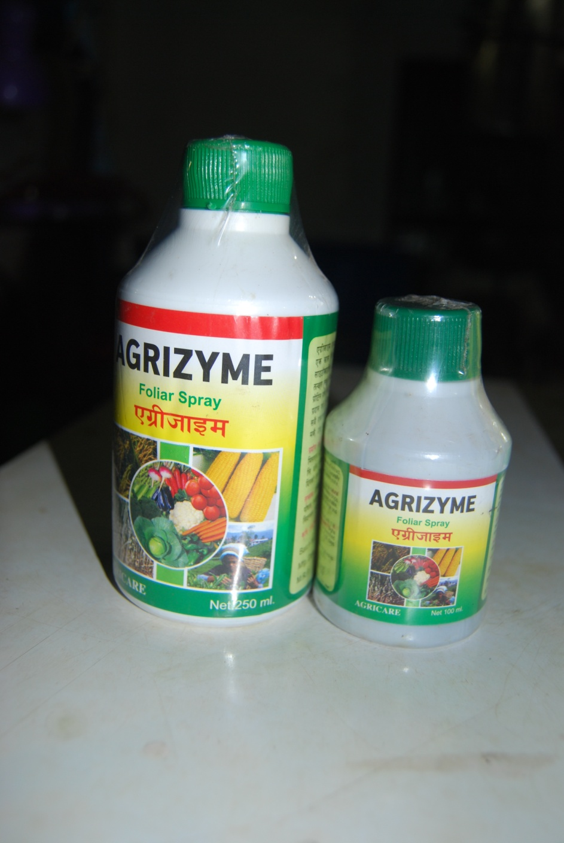
Agrizyme
Composition: A complex mixture of special kind of sea-weed extract containing Natural Enzymes, Auxin precurusors, Cytokinine & Naturally Chelated Micronutrients forfified with Protein Hydrolysate
Mode of action: Agrizyme provides immediate results due to its natural assimilable chelated nutrients and growth activators. It increase crops quality and yield. It can be used in all types of crops like Paddy, Maize, Sugarcane, Tea, Tobacco, Vegetable, Potato, Mango, Apple, Orange and many other crops.
Method of application:
1 ml Agrizyme liquid is to be mixed with 1 lit of water thus 300 lit solution can be prepared and sprayed over 1 Bigha of standing crops/plants .Both side of the leaves must be drenched properly on spraying. At list 3 sprays are required every 15-20 days interval.
FOR AGRICULTURAL USE ONLY

Slide 7
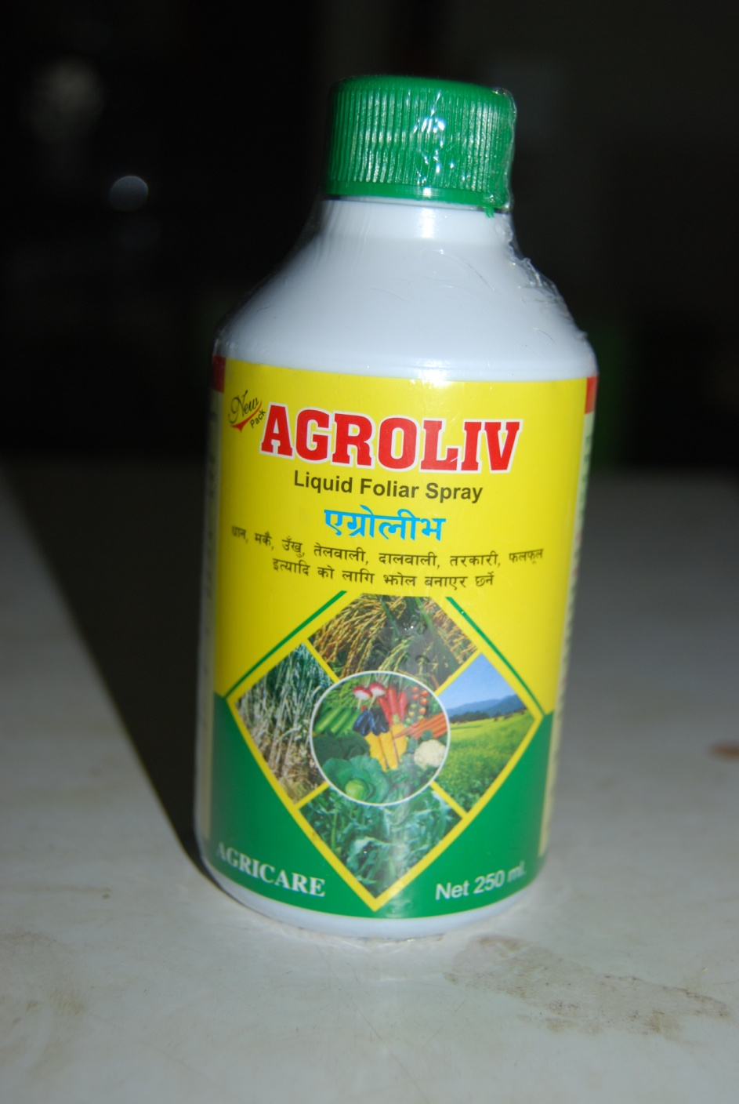
Agroliv
AGROLIVE is balance micronutrients for optimum growth and high yield of crops.
Preparation of spray solution: Dissolve 250 ml.Agroliv in 100 lit. water thus prepare 300 lit. solution and spray over 1.5 acre(Approx) of standing crops. Both surface of leaves should be drenched properly.
Cereals: 1st spray 3 to 4 weeks after sowing of transplantation.2nd spray 2 to 3 weeks after 1st spray.
Oilseeds/pulses & vegetable : 1st spray: 3 to 5 weeks after sowing or transplantation . 2nd spray : 2 to 3 weeks after 1st spray.
Fruits and other crops: 2 sprays during 2-3 leaf stage or suitably during peak growth period
Agroliv: can be used with all types of pesticides or fungicides excepts chemicals that produce alkalinity.
Caution: Use the solution immediate after preparation .After spraying ,wash hands and contaminated parts of the body and sprayers as well.
FOR AGRICULTURAL USE ONLY

Slide 8
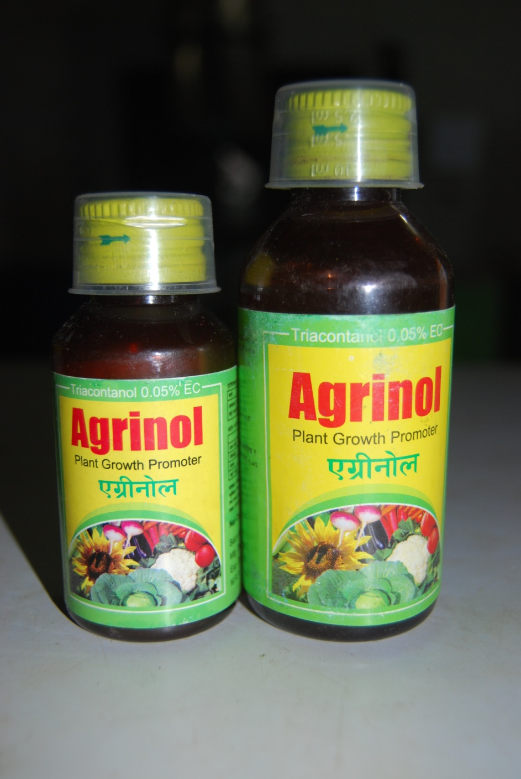
Agrinol
Composition
Triacontanol A.I. 0.05% w/w(min), Emulsifiers (Ionic and Anionic
Alkyl Aryl Sulphonate and
Polyoxyethylene ether) 0.05% w/w Aromatic solvent Q.S.
Total: 100% w/w
First aid: if ingested induce Vomiting.
Treatment: Symptomatic treatment .keep out of reach of children .
Precautions: Store in cold, dry place. Keep away from feed stuffs, children & empty food stuff containers & animal feed
Avoid contact with skin & eyes.

Slide 9
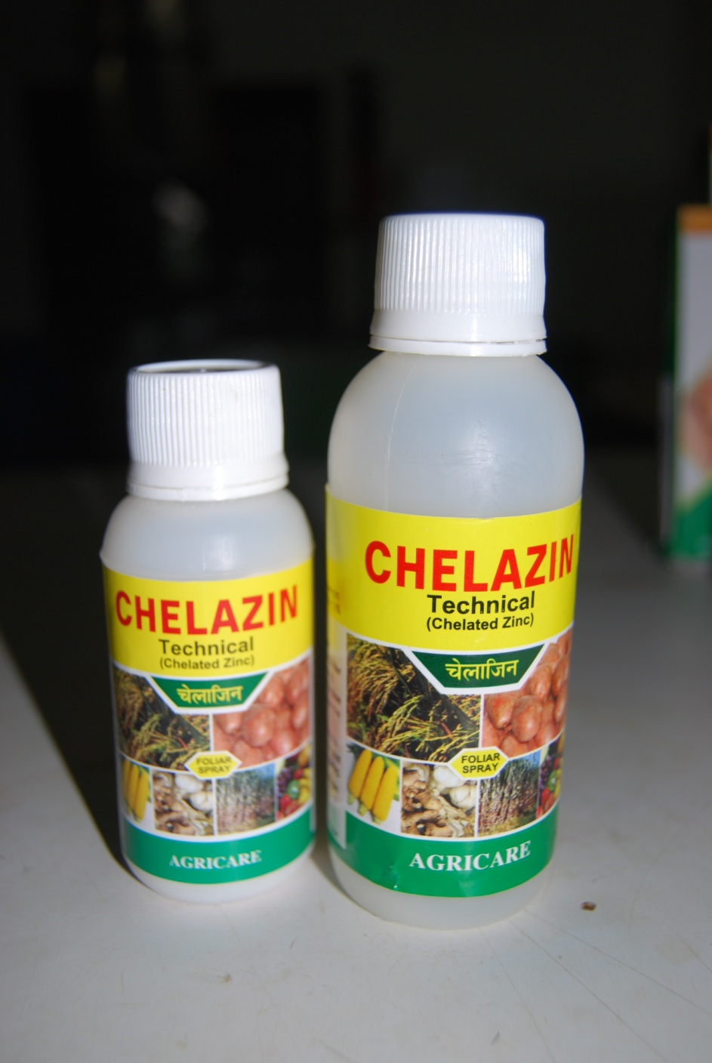
Chelazin(chelated Zinc)
Method of use
Foliar spray: 50 gm of Chelazin(technical) is to be dissolved in 50 lt of water and spray over 0.2 acre(6 katha App.)of standing depending upon the severity of zinc deficiency.
2. Soil application:
250 gm of chelazin is to be mixed with 5 kg soil or compost fertiliser and apply before or after sowing .

Slide 10
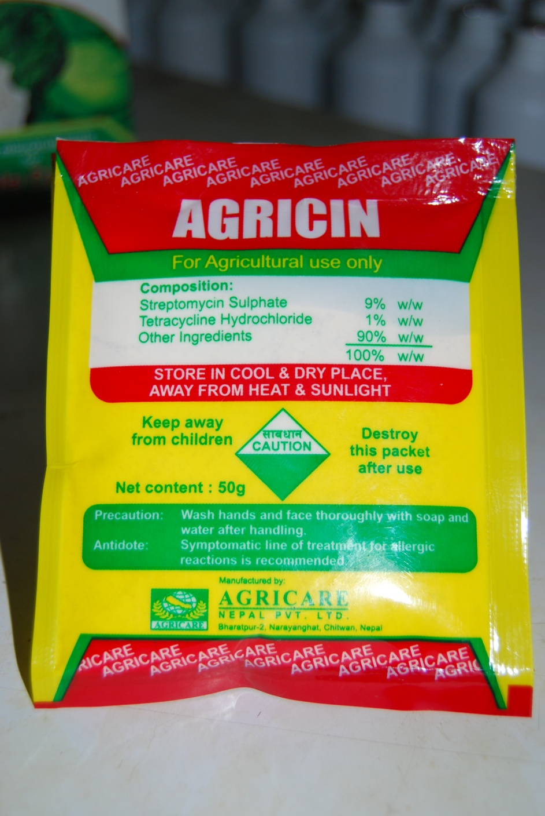
Agricin
Composition:
Strptomycin Sulphate 9% w/w
Tetrsacycline Hydrochloride 1% w/w
other ingredients 90% w/w
Precaution: wash hands and face thoroughly with soap and water after handling .
Antidote: Symptomatic line of treatment for allergic reactions is recommended.

Slide 11
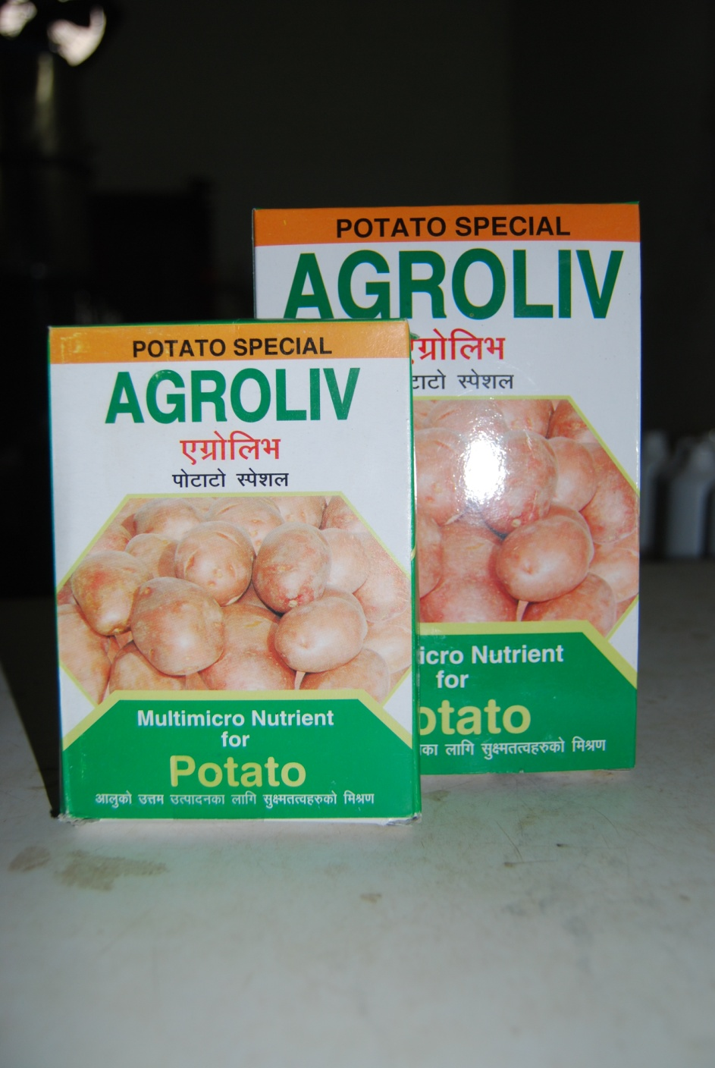
Agroliv(potato special)
Nutrients contents on % basis
Zinc 6.00%
Manganese 2.50%
Molybdenum 0.03%
Potash 5.00%
Phosphorus 5.00%
Boron 1.50%
Copper 0.25%
Nitrogen 5.00%
Sulphur 4.00%
Method of use :
For soil application: Apply 10kg-15kg of Agroliv potato special per hector (500 gm-750gm per 1.5 katha) at the time of sowing
As foliar spray: 500 gm Agroliv potato special is to be dissolved in 200 lit. of water and spray on both the surface of the leaves.
Agroliv potato special: (powder) or Agroliv liquid foilar spray can be mixed with fungicides & insecticides.
1st .Spray: 34-40 days after germination
2nd .Spray: 15-20 days after 1st spray

Slide 12
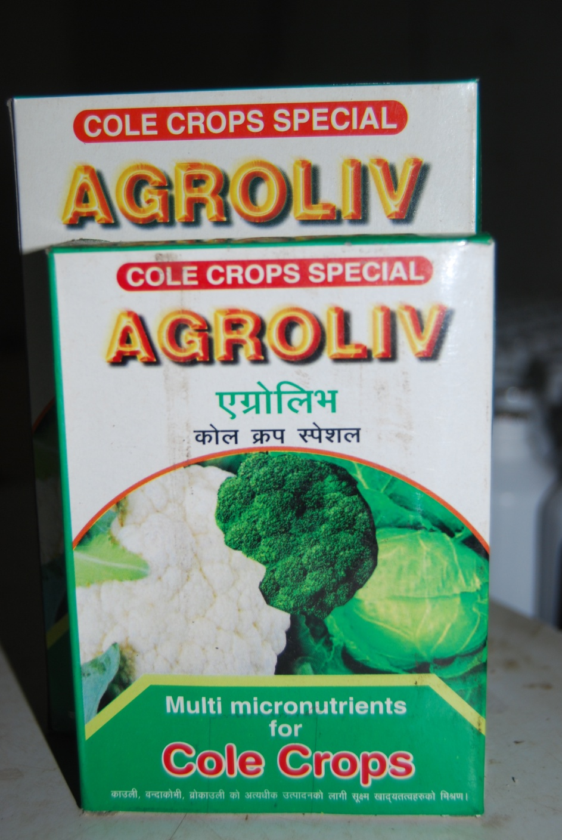
Agroliv(Cole crop special)
Nutrients contents on % basis
Boron 3.0%
Manganese 1.5%
Magnesium 4.0%
Molybdenum 0.03%
Nitrogen 4.5%
Sulphur 2.0%
Zinc 3.0%
For soil application:
Apply 6 kg Agroliv cole crops special per Acre (i.e.12 katha) (500 gm per katha) at the time of sowing. Dose may be increased up to kg per acre in sever deficiency of micronutrients.
For foliar spray: 500 gm Agroliv Cole Crop Special is to be dissolve in 150-200 lit of water and spray over crops of one acre.
1st spray: at 15-20 days old plant
2nd spray: 10-15 DATS or 20-25 days after 1st spray.
3rd spray: 15-20 days after 2nd spray.
Agroliv Cole Crop Special powder or prepared liquid can be mixed with fungicide and insecticide

Slide 13
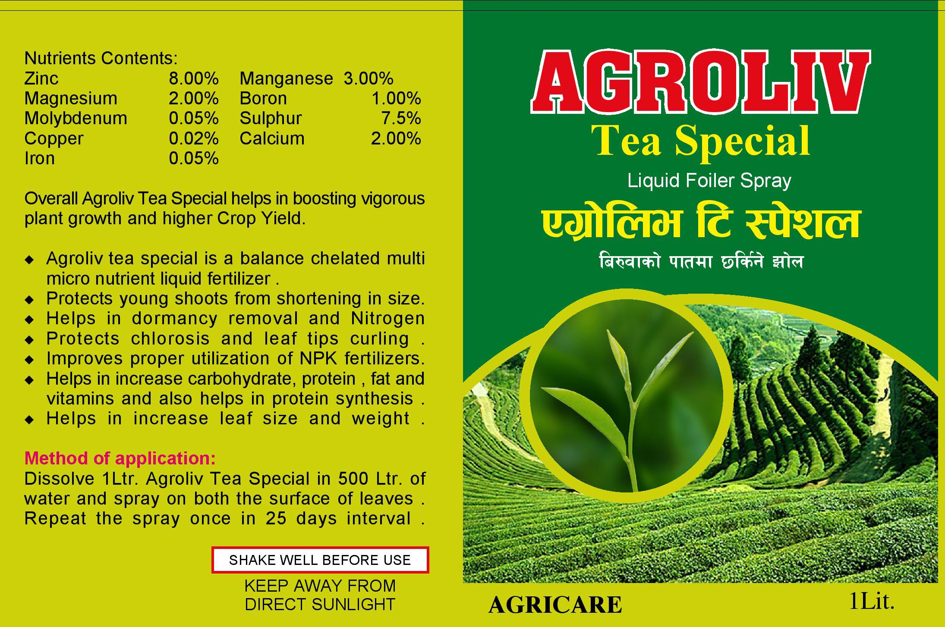
Agroliv(Tea Special)

Slide 14
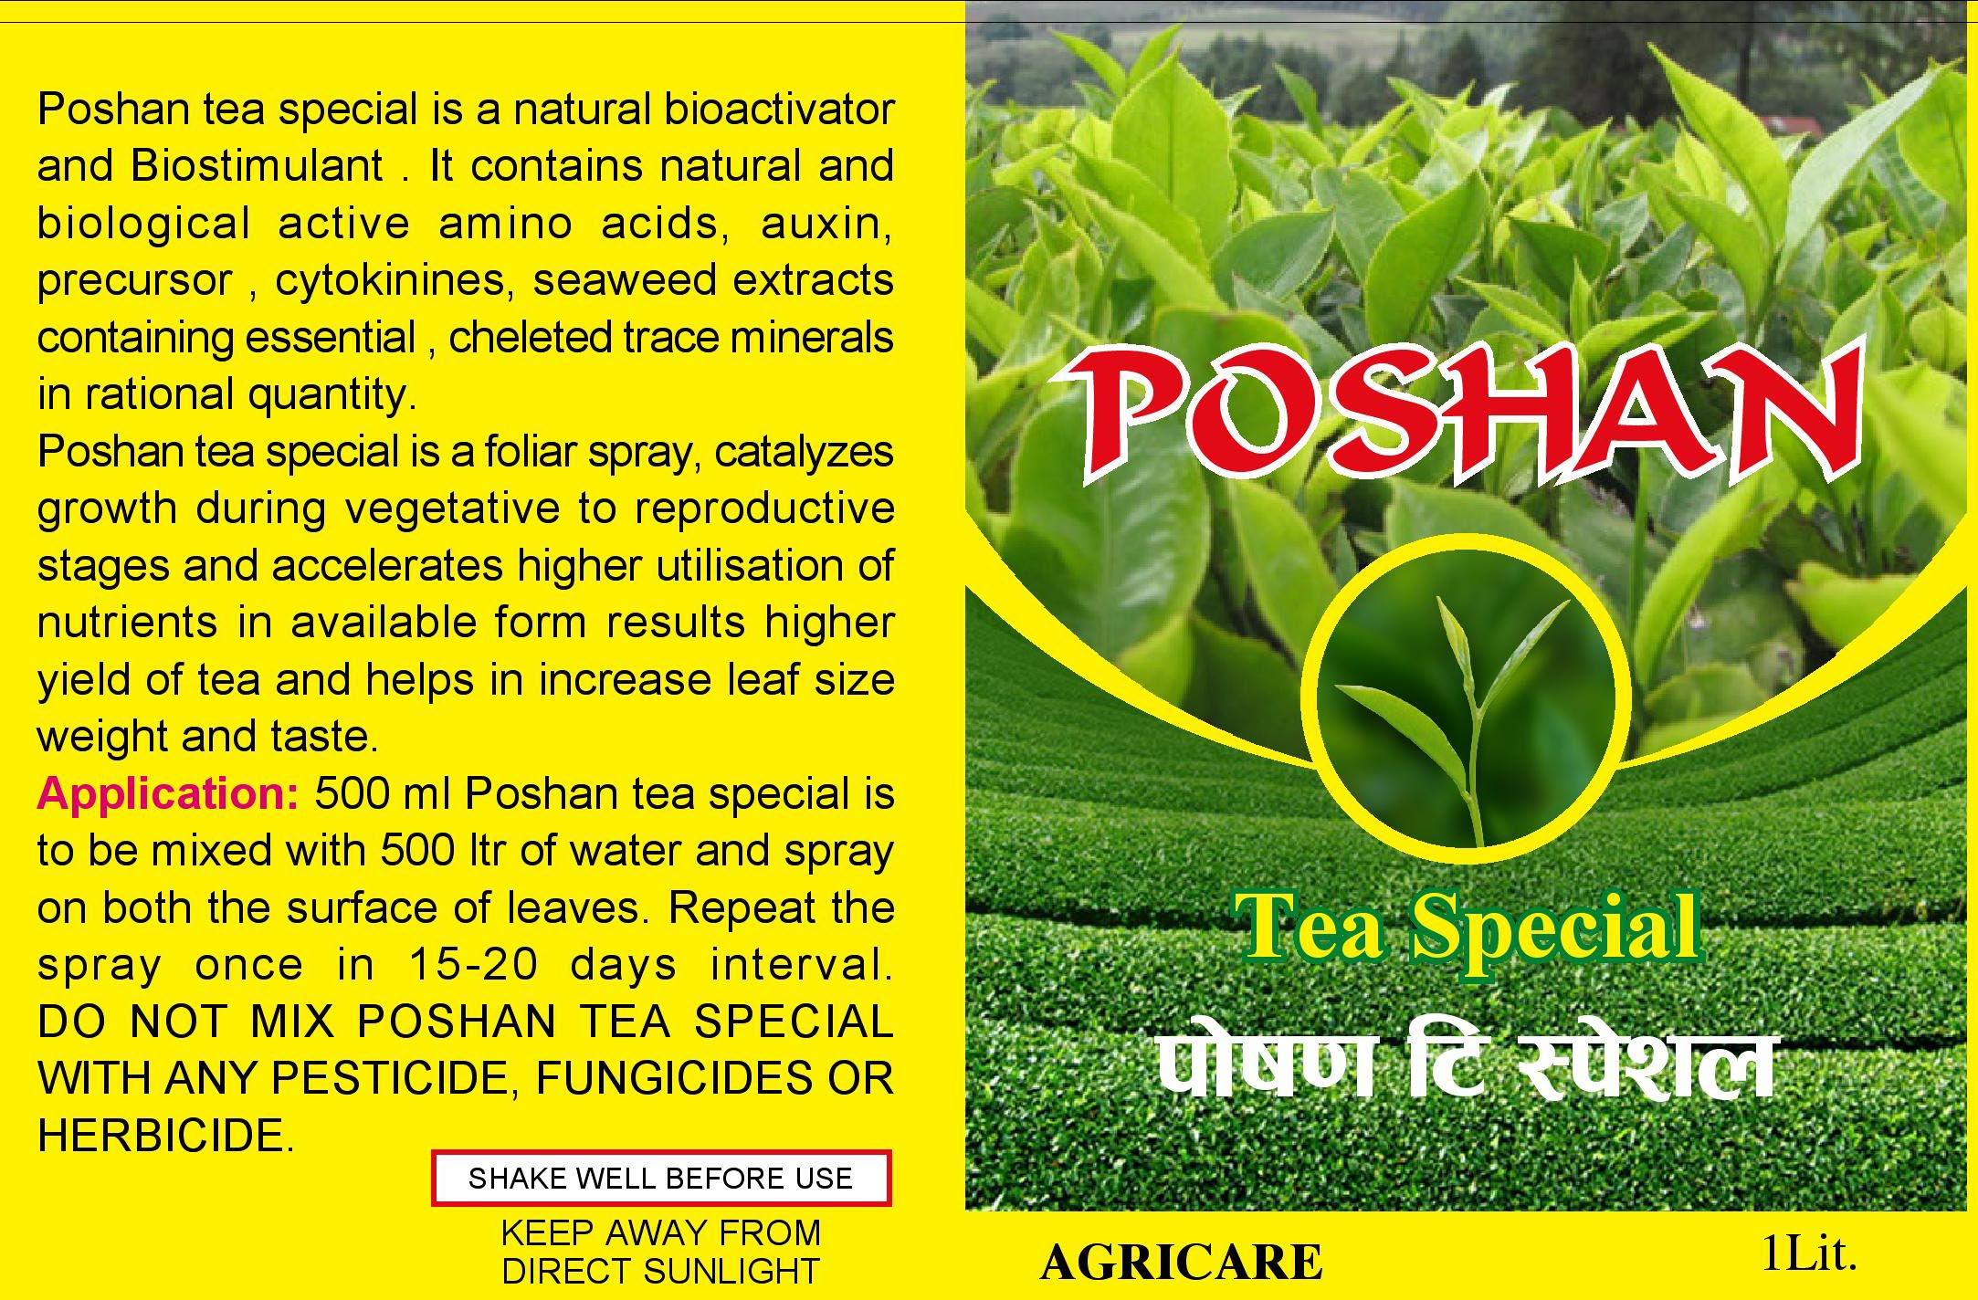
Poshan(Tea special)

Slide 15
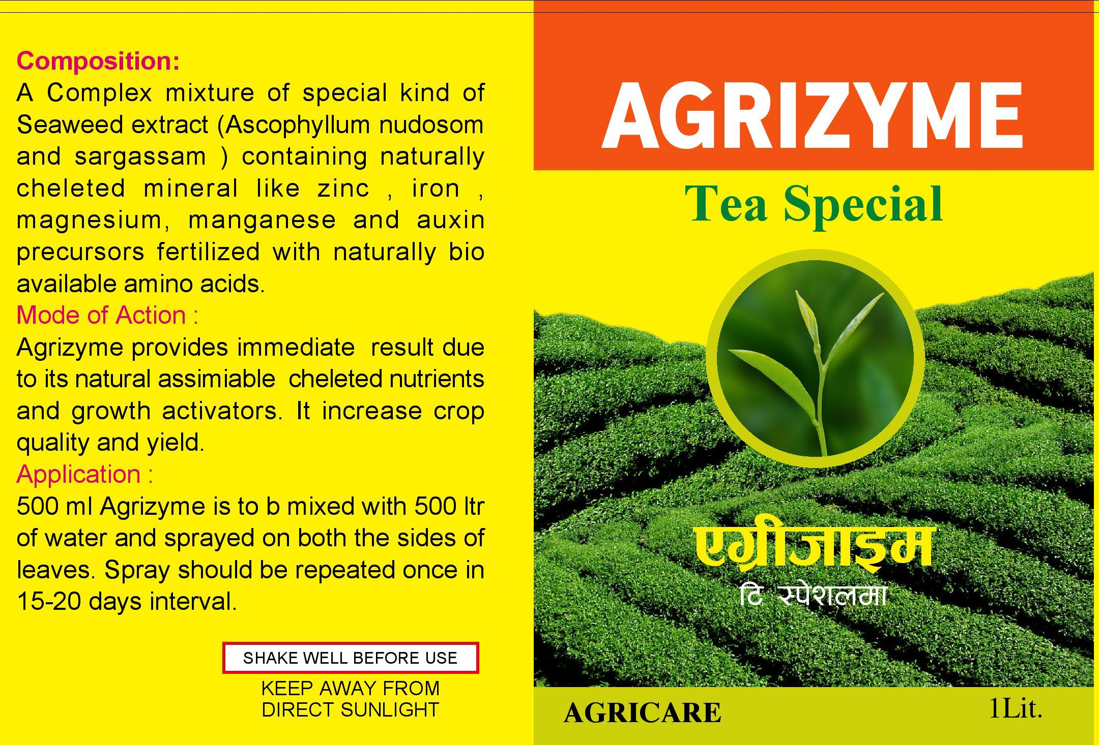
Agrizyme(Tea Special)

